Slide 1


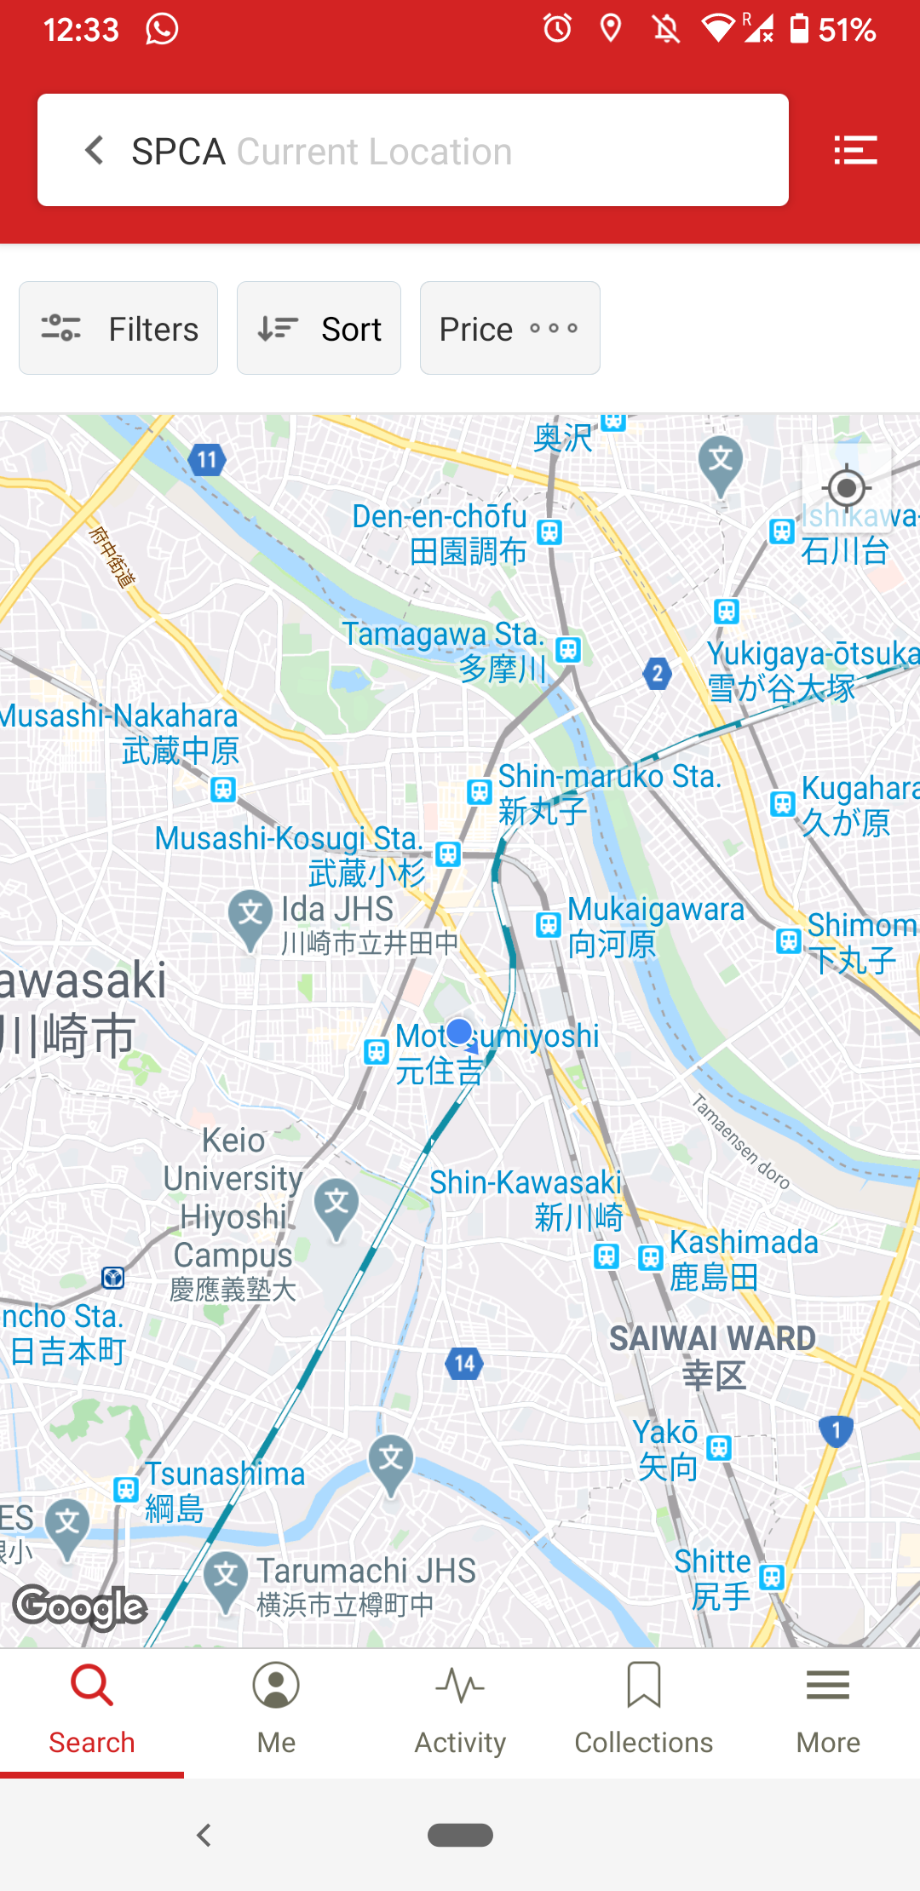
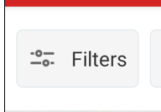




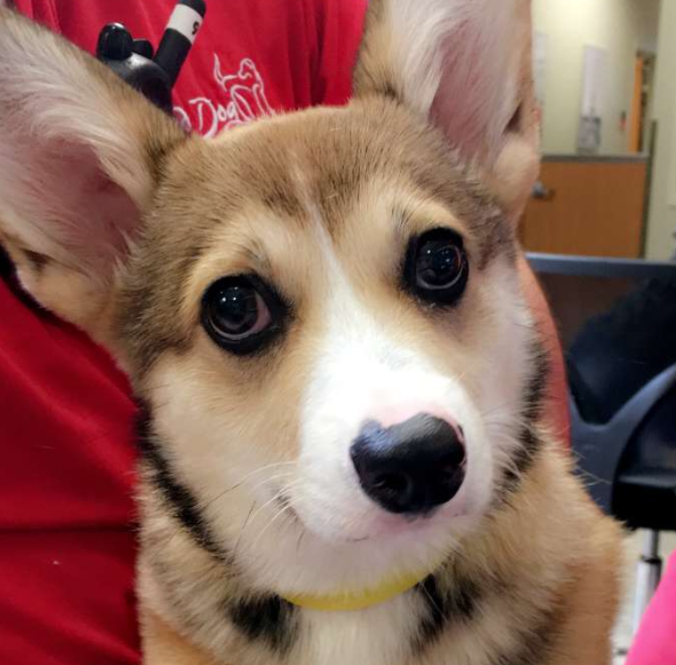
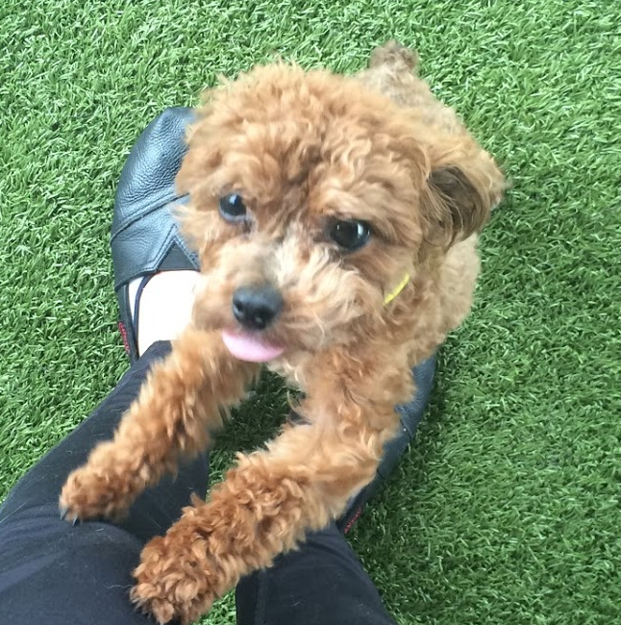
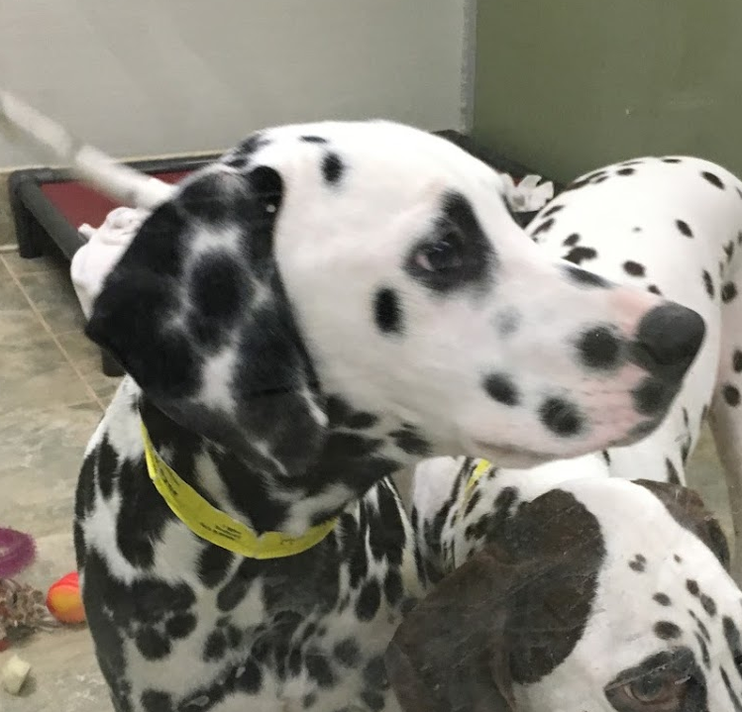
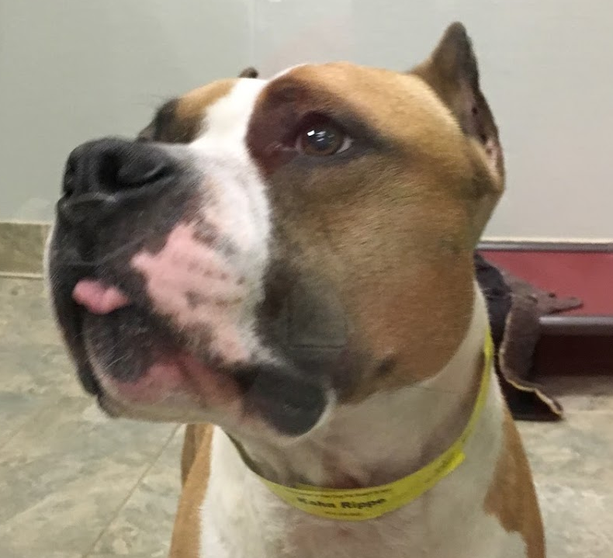





7.1 User Main Screen
Animal Shelter
Current Location
Pet Filters
Distance
How can I help?
Click for list view
NEEDED:
Pet Filters Icon (look at yelp)
Distance Icon
Swipe Mode Icon
I want swipe mode to stick out from the rest;
Maybe a bolder color? Different color altogether?
Favorites Icon
Better shorthand for “How can I help?”
Icon for Pins (optional)
Icon for cat by itself, dog by itself, “exotic” by itself,
And then cat + dog, cat + exotic, dog + exotic, and all three together (total of 7)
Icon to represent that volunteers are wanted
Icon to represent that donations are needed
Tamagawa Humane S…
SAAP
SPCA
1.2 km
…
Marco
Suzy
Pebbles
Sir Hands…
SPCA
Search
Me
Swipe Mode
Favorites
More

Slide 2
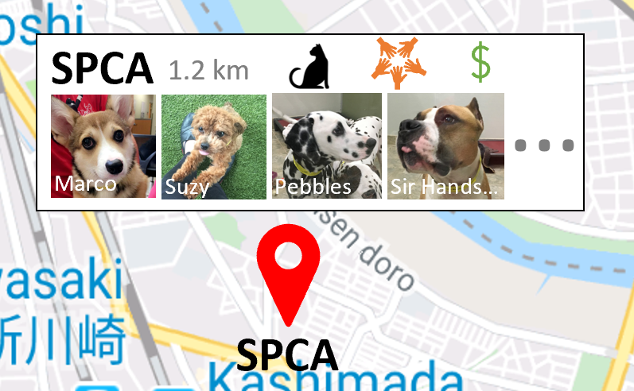
Location Info Tile
If you wish to play around with this layout,
Please feel free!!
Info I want to be represented here:
Name (sometimes long like:
Animal Friends Humane Society of Hamilton
so…. :/
Distance
What animals are available (best shown thru icon?)
If volunteers are accepted (grayed out or not shown otherwise)
If they need donations (grayed out or not shown otherwise)
An initial subset of available pets ☺

Slide 3

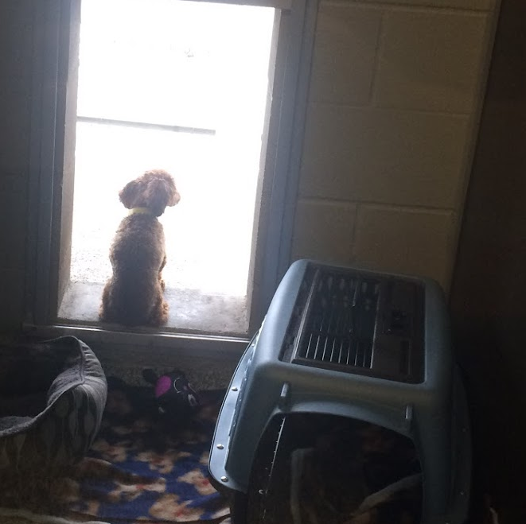
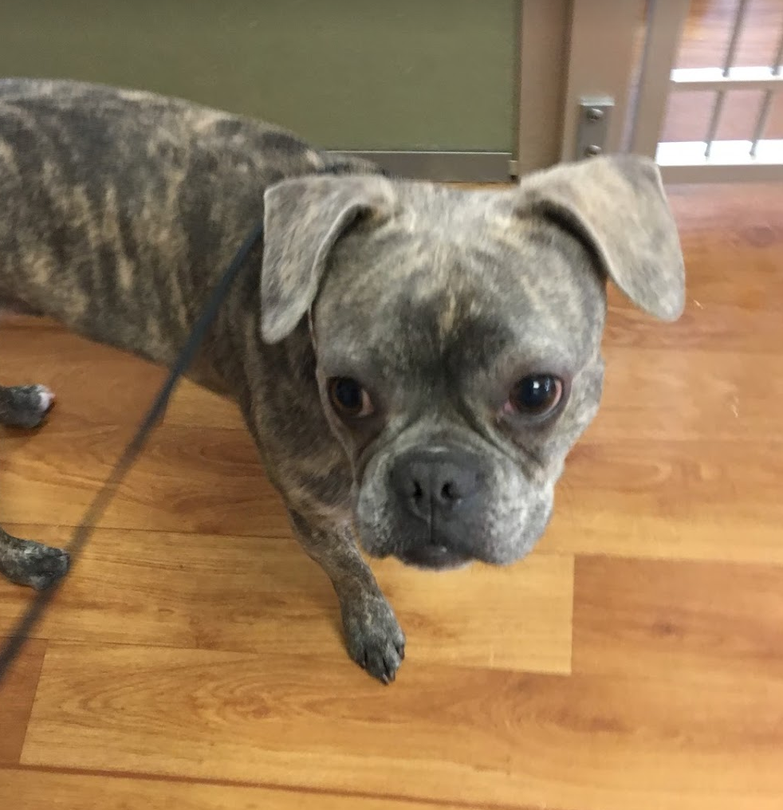
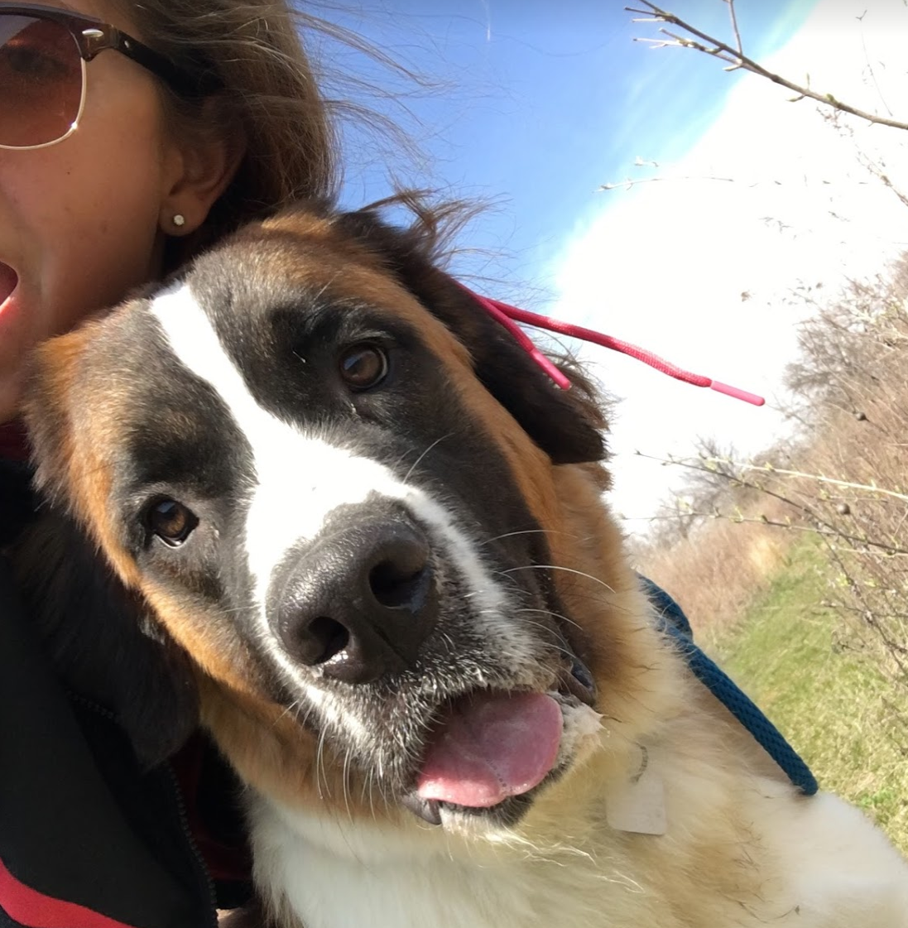
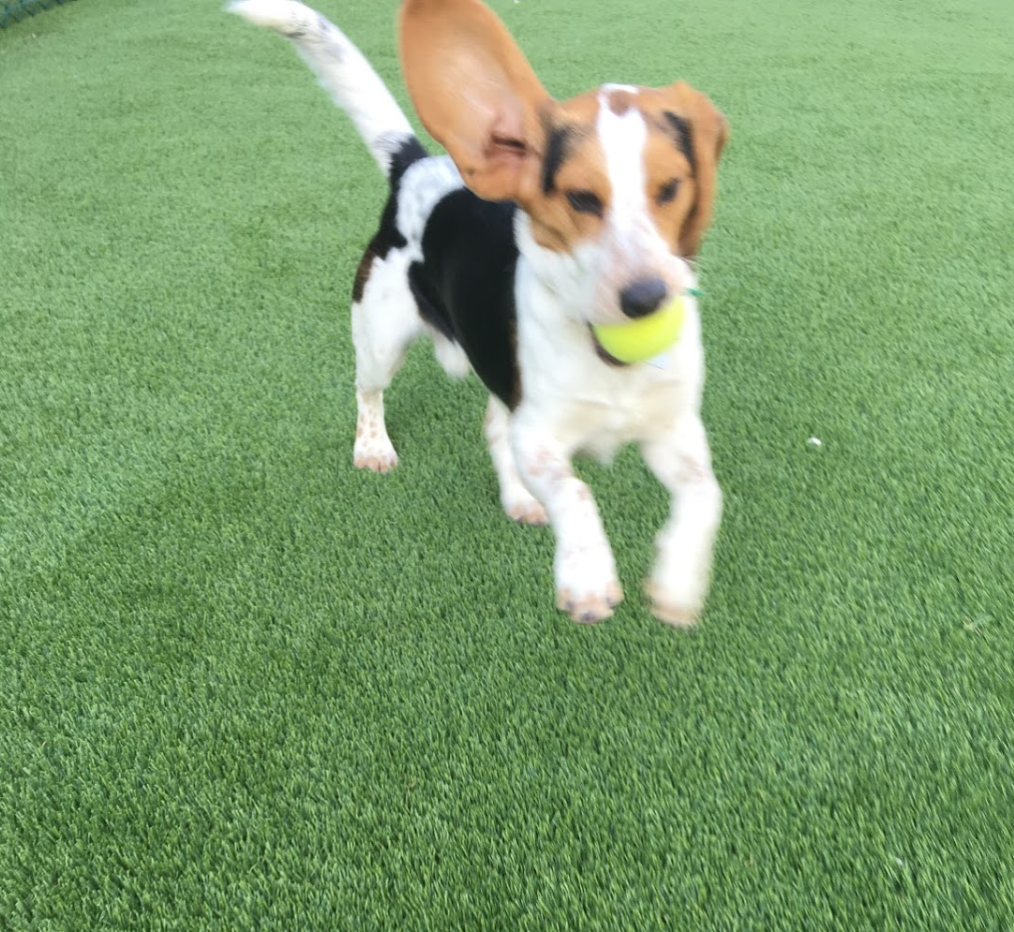
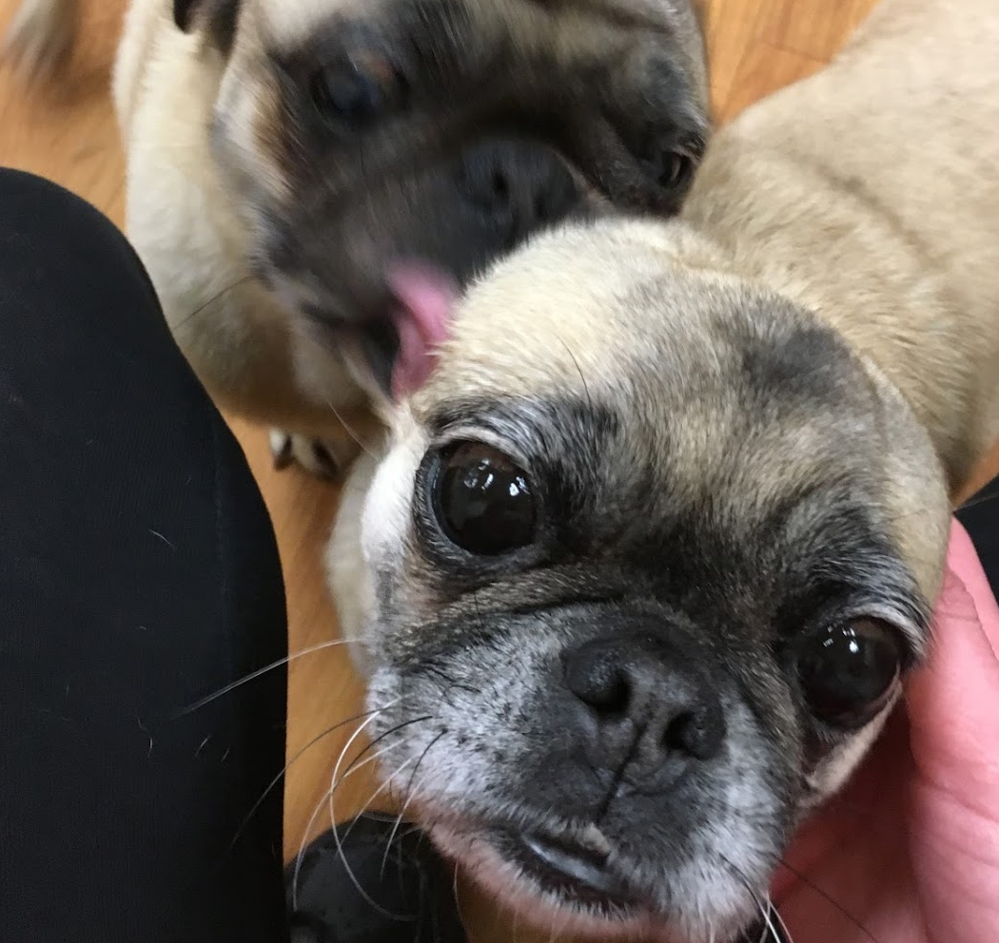
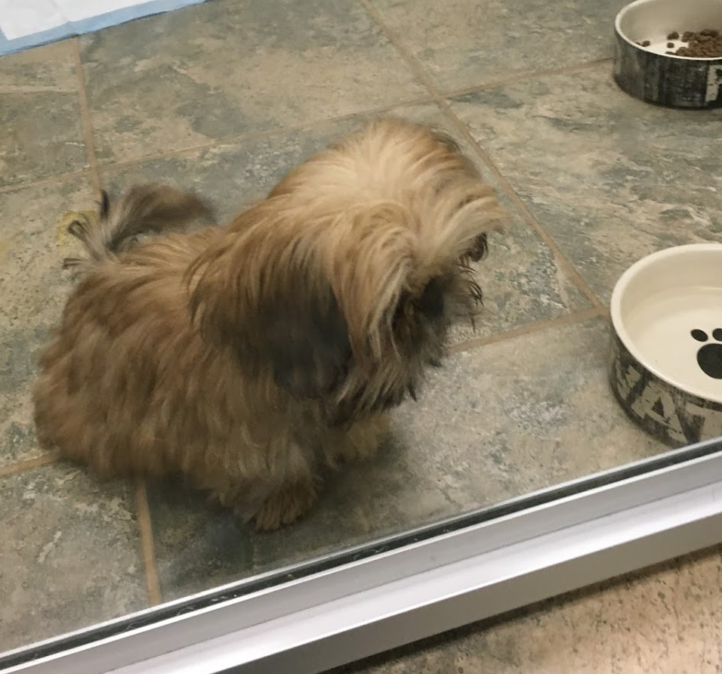
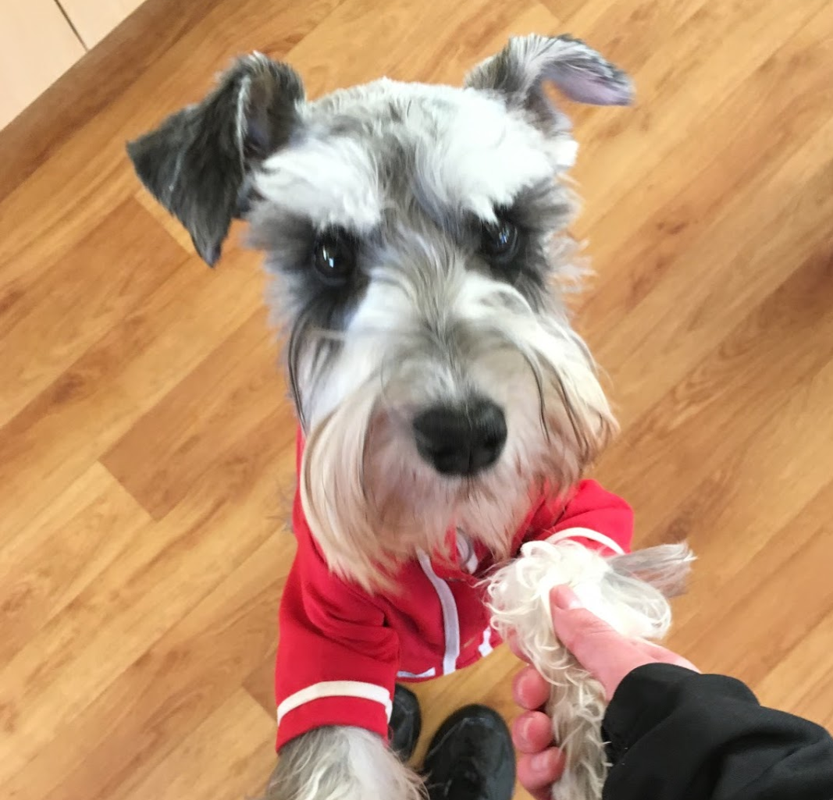
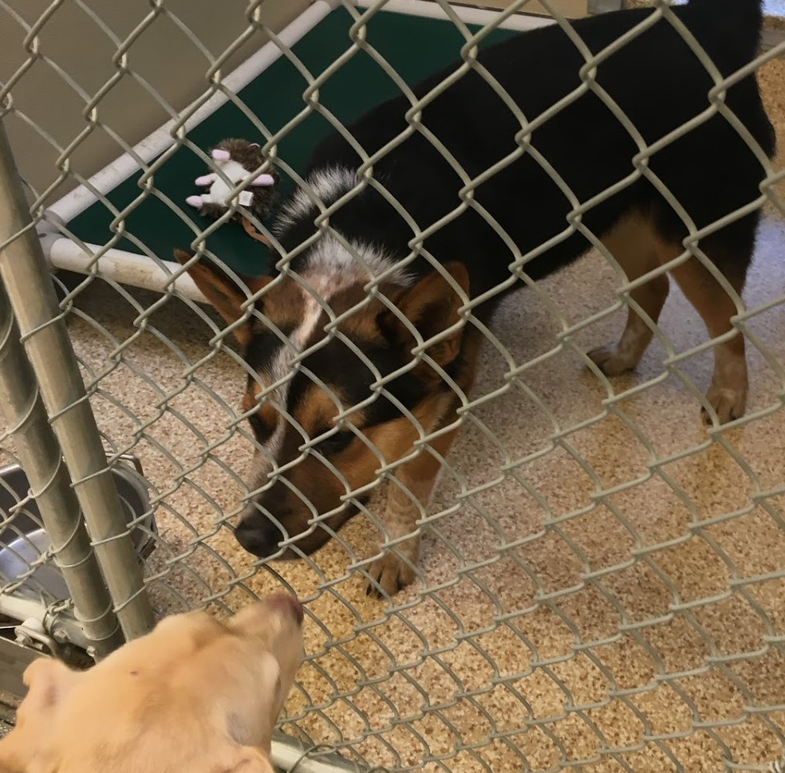
7.2 List View
Animal Shelter
Current Location
Pet Filters
Distance
How can I help?
SPCA Cincinnati
1.2 Km
Cats, Dogs, Others
Volunteers OK
Donations Needed
125 Wallaway St., Cincinnati, Ohio
Tamagawa Humane Society
0.8 Km
Cats, Dogs
Volunteers OK
Donations Needed
Marco
374 Hoppy Avenue, Cincinnati, Ohio
SPCA
SAAP Clifton
3.2 km
Cats, Dogs
Volunteers OK
Donations Needed
Marco
374 Hoppy Avenue, Cincinnati, Ohio
Search
Me
Swipe Mode
Favorites
More

Slide 4
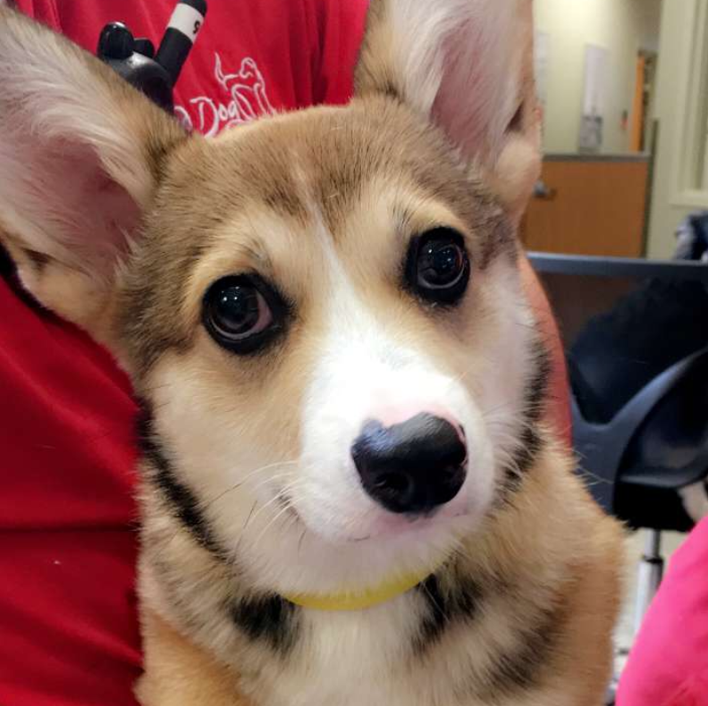



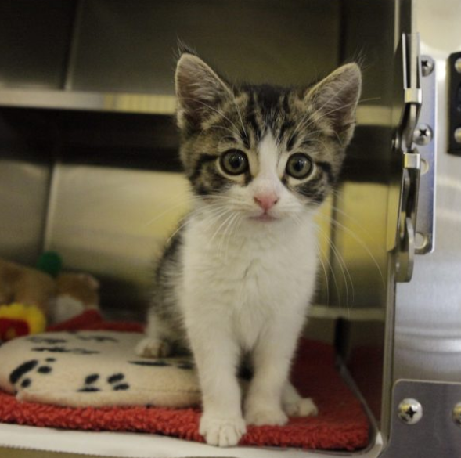
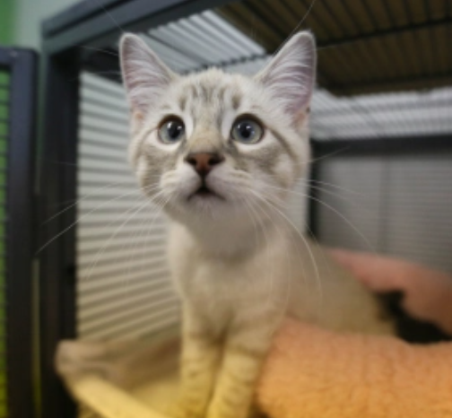
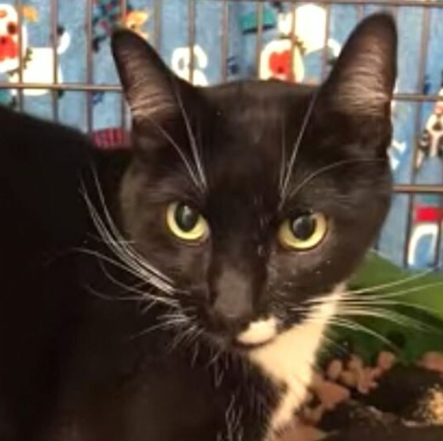
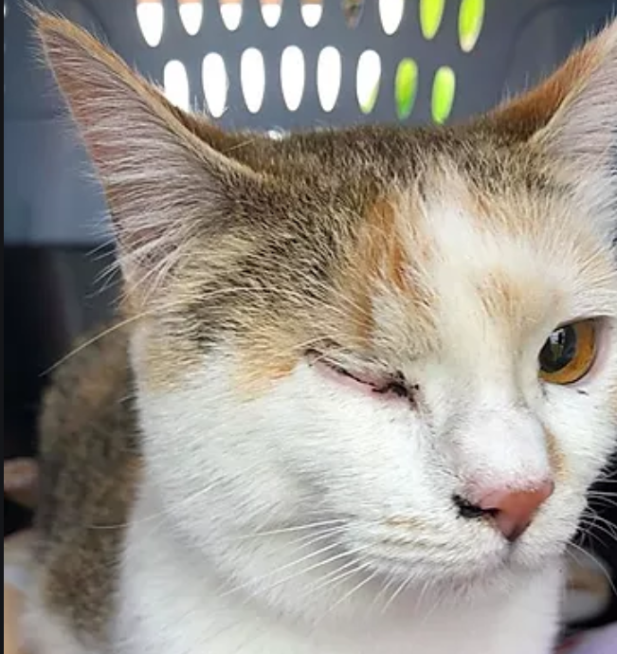
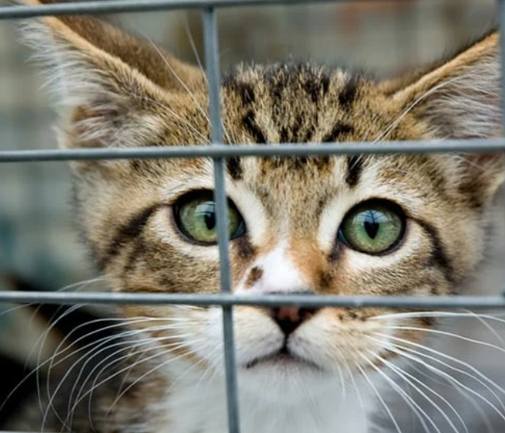
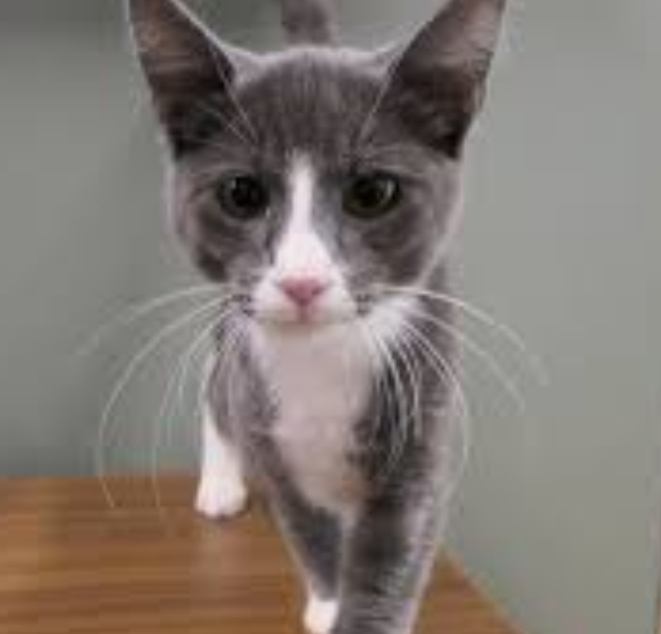

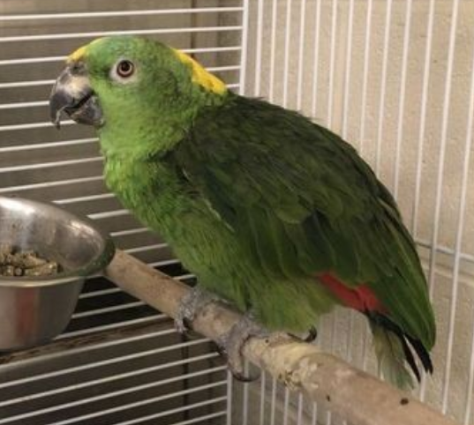
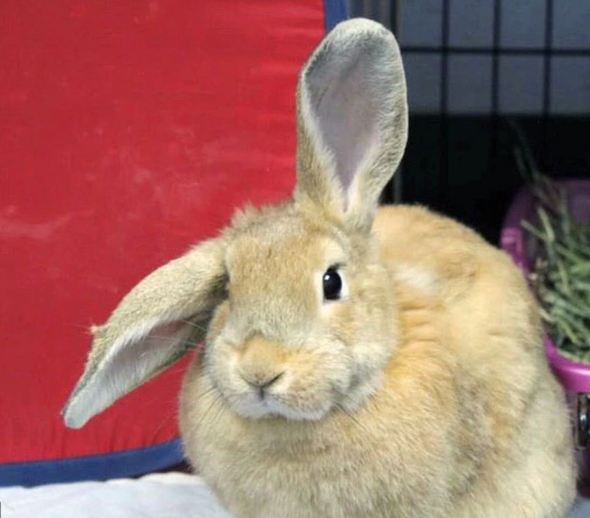

9 Specific Tile
←
…
Need:
Dog Icon
Cat Icon
“Other” Icon
Can be the same as before?
SPCA Cincinnati
Animal Shelter · Cats, Dogs, Others
Volunteers OK
Donations Needed
Dogs
Missy
Pebbles
Thor
Sir Nicholas
Scout
Q
Cats
Kittie
Rosa
Tigre
Nicole
Miss Prowl
A
Others
Search
Favorites
More
Me
Swipe Mode
Favorites
Swipe Mode

Slide 5



9 Specific Tile
←
SPCA Cincinnati
…
Others
Zack
Squirt
125 Wallaway St., Cincinnati, Ohio
Monday – Friday | 9 AM – 12 PM 2:30 PM – 6 PM
Saturday | 11 AM – 4 PM
Sunday | Closed
Volunteers OK
Here’s what the organization says:
Please attend one of our 2-hour orientation sessions listed on our website. Volunteers can participate in the following activities:
Clean cages
Socialize the cats
See more
Not in Need of Donations
Search
Me
Swipe Mode
Favorites
More
Swipe Mode

Slide 6



How Can I help Volunteer Tab
←
How Can I Help?
Volunteer
Donate
SPCA Cincinnati
1.2 Km
Please attend one of our 2-hour orientation sessions listed on our website. Volunteers can participate in the following activities:
Clean cages
Socialize the cats
See more
List the shelters that allow volunteers by order of distance
Filter by type of animal they have – Dog, Cat, Exotic (fix icon)
-- will show it’s selected based on boldness
** another icon version needed for that!!**
** Need to figure out how to format the three animal icons bar
SAAP Clifton
3.2 Km
Please apply on our website SAAP.org/volunteer. Volunteers attend adoption events held on the weekends at various locations. Volunteers comfort the animals and take them out on bathroom breaks. They’re also responsible for set-up and clean-up before and aft…
See more
SAAP Loveland
5.1 Km
Please apply on our website SAAP.org/volunteer. Volunteers attend adoption events held on the weekends at various locations. Volunteers comfort the animals and take them out on bathroom breaks. They’re also responsible for set-up and clean-up before and aft…
See more
Hamilton Humane Society
8.1 Km
Search
Me
Swipe Mode
Favorites
More

Slide 7
How Can I help Donate Tab
←
How Can I Help?
Volunteer
Donate
Filter Items
Tamagawa Humane Society
0.8 Km
Blankets
Toys
Purine Soft Puppy Food
Lysol Spray
Clorox Wipes
Towels
List the shelters that allow volunteers by order of distance
Lint Roller
Puppy Pads
Kitty Soft Food
See more
SAAP Clifton
3.2 Km
Kitty Soft Food
Blankets
Clorox Wipes
Lint Roller
Purine Soft Puppy Food
Towels
Puppy Pads
Toys
Lysol Spray
See more
SAAP Loveland
5.1 Km
Towels
Toys
Purine Soft Puppy Food
Lysol Spray
Puppy Pads
Kitty Soft Food
Lint Roller
Clorox Wipes
Blankets
See more
Tamagawa Humane Society
8.1 Km
Search
Me
Swipe Mode
Favorites
More

Slide 8
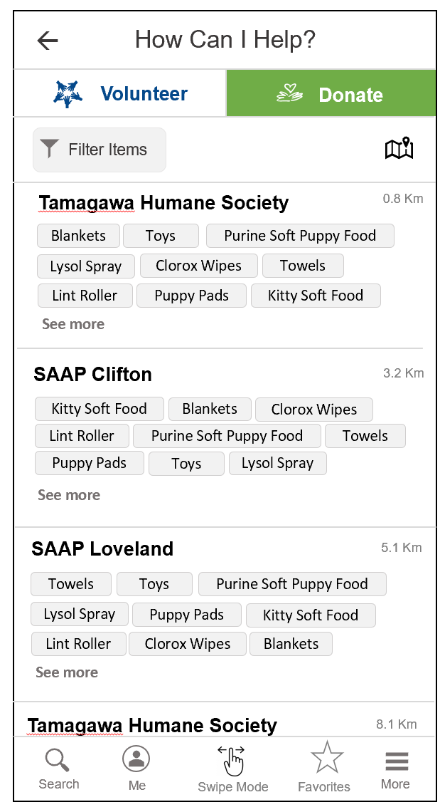
Filter Donation Items
Filters
Categories
Food
Cleaning Supplies
Bedding/
Towels
Toys
Misc.
Keywords
Lysol
Please hit enter after each individual keyword
CANCEL SEARCH

